Slide 1


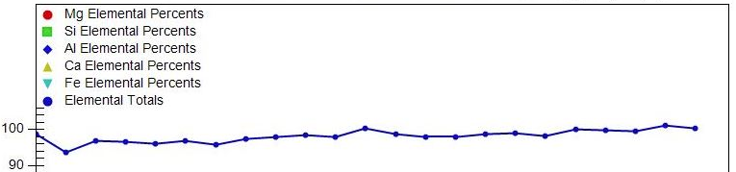
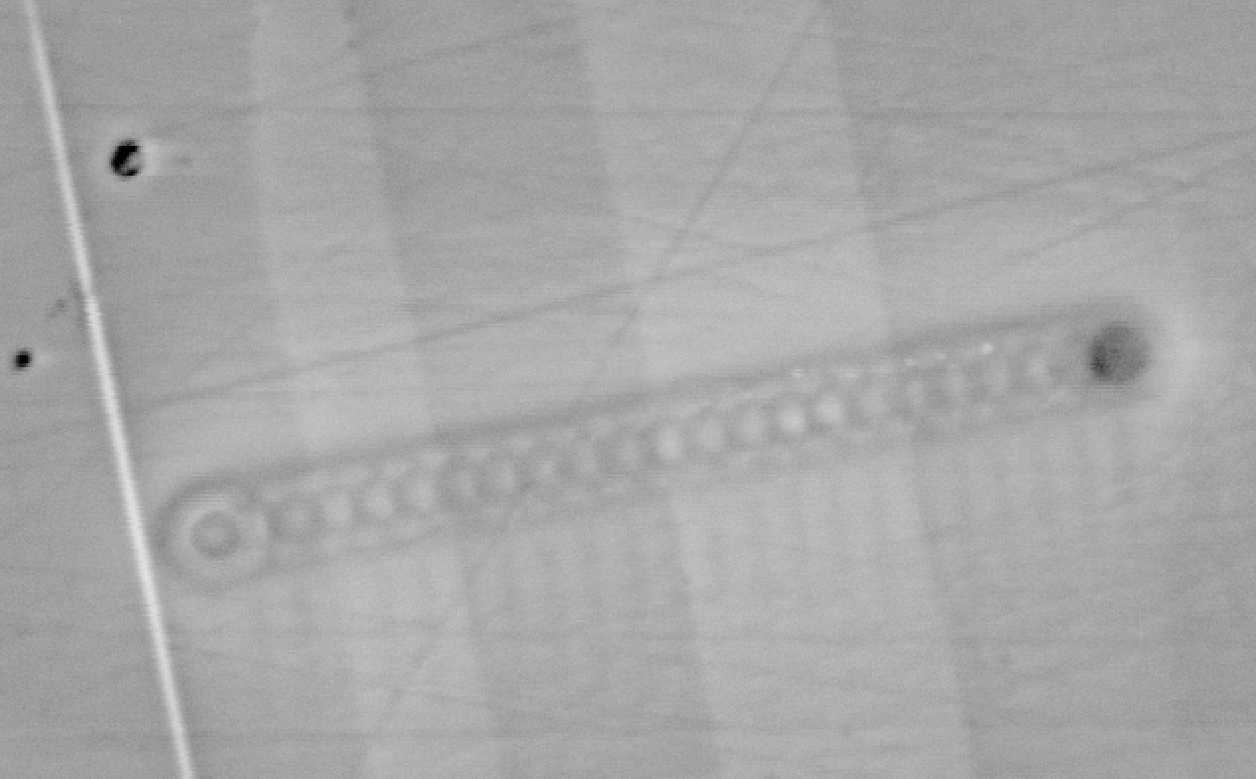
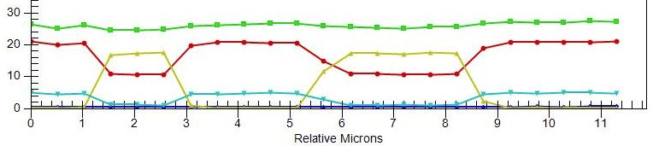
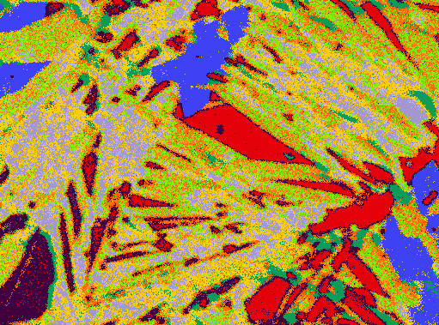
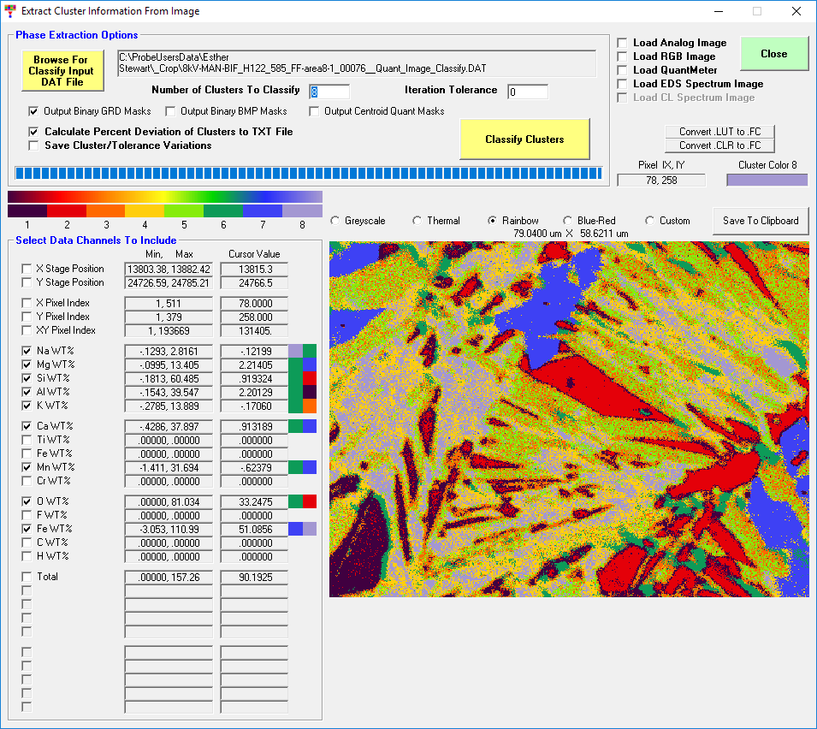
Sub-micron Mineral Quantification:
EPMA with Low Accelerating Voltage
A. Moy¹ and J. Fournelle¹
¹University of Wisconsin-Madison, Geoscience Department,1215 W Dayton Street, Madison, WI 53706, USA
Advances possible with low accelerating voltage EPMA
There is universal appreciation of the benefit of field emission sources for acquiring high magnification SEM images. However, to perform high-resolution quantification maps, decreasing the beam size is not enough -- the accelerating voltage also must be dropped to shrink the electron interaction volume. By using low accelerating voltages (e.g. 7-8 kV), we were able to quantify sub-micron features and to perform high-resolution quantitative X-ray maps and spot measurements. The following work was done using our CAMECA SXFive FE with Probe for EPMA software which allows the quantification of X-ray maps using the Mean Atomic Number (MAN) background correction method, reducing the acquisition time as only one pass per element is necessary (no background measurements). Also, dropping the keV creates complications, e.g. we no longer can use the Fe Ka line – and using an Fe L line can add significant complexity. – We have made advances in this regard: see papers in American Mineralogist and Microscopy and Microanalysis, being published this summer.
Quantification of lamellae of Cpx in Opx
From the earliest years of geological EPMA, the determination of the chemical composition of thin lamellae in minerals has been one challenge. Here, we demonstrate the viability of sub-micron resolution with 7 keV EPMA of thin lamellae of
cpx in an opx host in a Kharchinsky (Kam-chatka) peridotite xenolith (sample KH03-88/PSY-16 of Gene Yogodzinski). We estimate the analytical spatial resolution to be ~600 nm.
Here, Fe La was used with “standard matching” technique (using pyroxene standards with similar Fe contents)
SE image of traverse across 1.6 and 2.8 micron cpx lamellae
10 microns
Banded Iron Formation, Baraboo, WI, USA
Many banded iron formation rocks contain very fine grain Fe-rich minerals, which are extremely difficult/impossible to identify optically in a 30 micron thick thin section. Here, perhaps for the first time, they can be identified.
Quantitative EPMA mapping/point analyses were performed to determine mineral composition of samples from the <1.7 Ga Freedom Formation, Baraboo, WI. The overall mineralogy of the studied samples includes chamosite, stilpnomelane, quartz, magnetite, hematite, ankerite, dolomite and siderite with interbedded detrital quartz and kaolinite. High spatial resolution quantitative maps performed at 8 kV show micron-scale reactions between primary reduced iron phases (chamosite) and secondary mixed Fe²⁺-Fe³⁺ minerals (e.g. stilpnomelane) of ranging composition.
L.A. Brengman and E.K. Stewart, E.D. Stewart, A. Moy, J.H. Fournelle and G. Segee-Wright
These phases were selected from an automated search of hundreds of possibilities.
 | Phase
1 | Eckermannite
2 | Quartz
3 | Stilpnomelane
4 | Thuingite
5 | Grunerite
6 | Biotite
7 | Ankerite
8 | Goethite
10 micron
Got an interesting sample with micron to sub-micron features?
We are looking for challenges! Clearly some features are too small, but we are looking for interesting samples with features from maybe 400 nm to 1-2 microns, which at traditional 15-20 kV EPMA are just too small.
[1] J.J. Donovan and T.N. Tingle, JMSA, 2(1) (1996), p. 1-7.
Support for this research came from the National Science Foundation: EAR13-37156 (JHF) and EAR15-54269 (JHF).

